Slide 1
Let’s Get Agile!
An overview of the Agile development methodology.
Trent Hesler
CS250-T5475
June 18, 2023

Slide 2
Agile Methodology
What is Agile?
Agile is a project development strategy that emphasizes flexibility and strives to eliminate central points of failure.
How does it differ from traditional project development?
Traditional (waterfall) development is a marathon, Agile is a series of sprints.
Waterfall development is resistant to change, Agile embraces it.
Waterfall emphasizes predictability, Agile emphasizes flexibility.

Slide 3
Agile Roles
Product Owner
Creates project vision
Communicates to/from client
Develops/grooms product backlog
Scrum Master
Supports development team, removes impediments
Facilitates communication
Keeps project moving, day-to-day
Development Team
Write code
Implement user stories
Cross-functional, diversified
Self-organizing
Tester
Tests each product iteration
Uses automated and manual testing
Provides feedback to development team

Slide 4
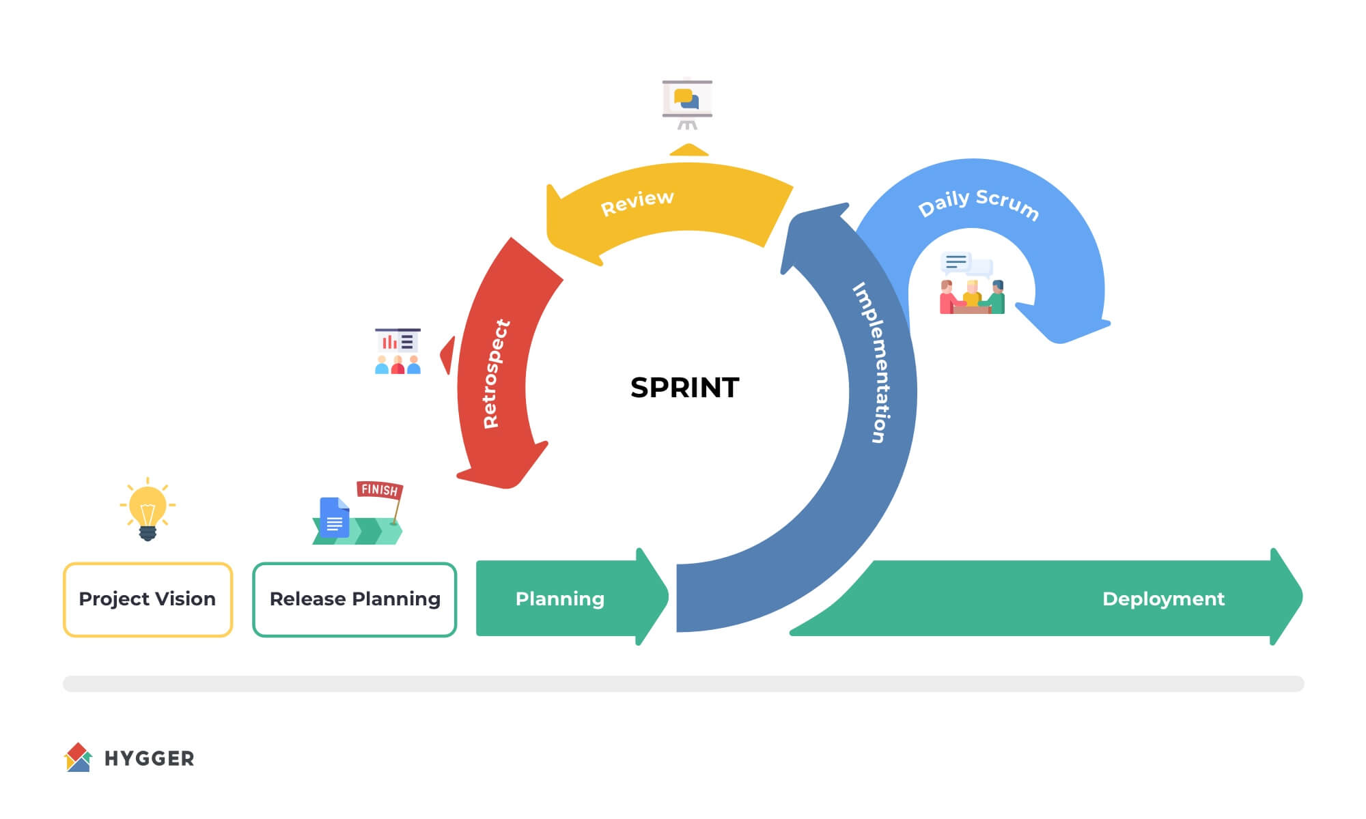
Agile Development Lifecycle Overview
Source: https://hygger.io/blog/what-is-scrum-lifecycle/

Slide 5
Planning Phase
Product owner meets with client/stakeholders to develop product vision and backlog
Initial Scrum planning session allows team to refine backlog and determine tasks per sprint
Development team and Scrum Master begin to self-organize
Source: https://hygger.io/blog/what-is-scrum-lifecycle/

Slide 6
Development Phase
Made up of multiple sprints
Each sprint has set goals to be accomplished (user stories to be implemented)
Daily Scrum standups keep team on-track, in communication
Retrospectives following each sprint allow team to learn and adapt
Source: https://hygger.io/blog/what-is-scrum-lifecycle/

Slide 7
Release
Final product is submitted to client for approval
Retrospectives are conducted to evaluate and learn
Team discusses lessons learned
Things that went well
Things that could’ve gone better
Insights for future Agile development projects

Slide 8
Comparison to Waterfall
Waterfall
Not very change-tolerant, changes cause delays
Planning is mostly upfront
Marathon development
Testing at the end
Agile
Changes expected, encouraged
Planning ongoing throughout
Iterative development sprints
Testing during/after each sprint

Slide 9
Example: Changes during development
To illustrate the differences between the two methodologies, I offer a story from the SNHU Travel project:
During development, meetings with the client and test groups revealed that it was necessary to change from a general travel booking site, to one that specialized in health and wellness retreats. Had we followed a waterfall approach to development, this change would likely have come at the end, during the customer approval phase, and would have required a ton of rework. Because of the Agile development style, this change was able to be incorporated with minimal friction.

Slide 10
Agile or Waterfall? Which is best?
Ultimately, the project management style must be tailored to each project. In projects where a high degree of certainty is needed, traditional waterfall may be best. For projects with lots of uncertainty and anticipated change, Agile may be preferable. According to a report from 2012, projects that employed Agile were three times more likely to succeed than their waterfall counterparts. However, a methodology somewhere between pure waterfall and Agile is generally best. By using a hybrid of the two methods, you can maximize the benefits of each while minimizing the drawbacks.

Slide 11
How to choose?
When deciding between Agile and Waterfall development strategies, ask the following questions:
What is the project timetable?
Are there few or many features to be implemented?
Are the product features likely to change during development?
What is the development team’s structure?

Slide 12
References
Cobb, C. G. (2015). The Project Manager’s Guide to Mastering Agile: Principles and practices for an adaptive approach. Wiley.
Schwaber, K., & Sutherland, J. (2013, July). The scrum guide. Scrum.org. https://www.scrum.org/scrum-guide
OneDesk. (2013, May 13). Agile adoption statistics 2012. The Spiceworks Community. http://community.spiceworks.com/topic/337418-agile-adoption-statistics-2012
Sergeev, A. (2020, June 10). What is Scrum Lifecycle. Hygger. https://hygger.io/blog/what-is-scrum-lifecycle/

Slide 13
This slideshow template is licensed under a Creative Commons Attribution-ShareAlike 3.0 Unported License. It makes use of the works of Mateus Machado Luna.

